Slide 1
Topic: Scale Diagrams EQ: How do I use a scale diagram?

Slide 2
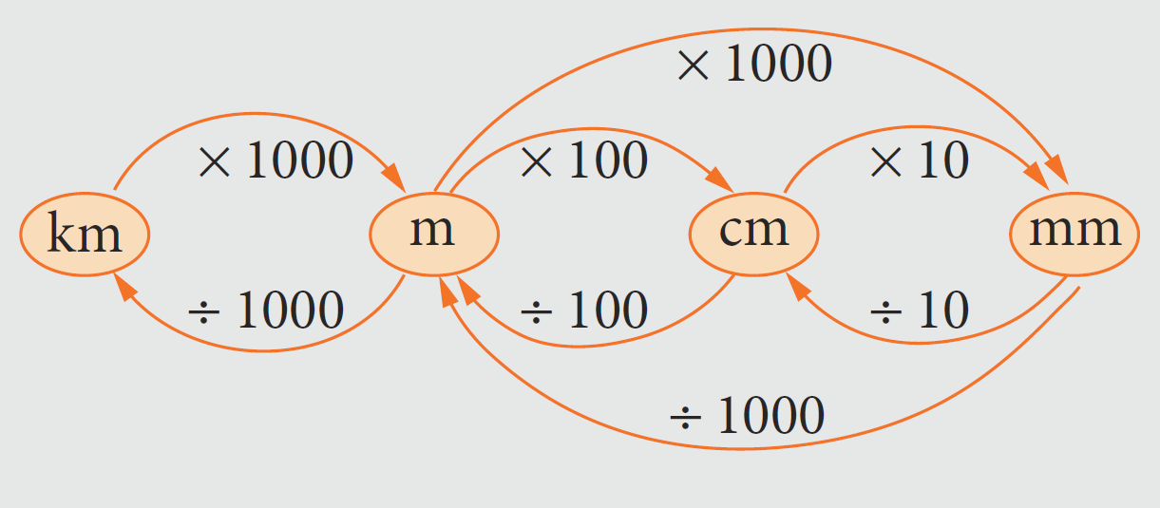
You may need this throughout this unit

Slide 3
24
7
30
Scale Diagrams
Date
EQ – How do you use a scale diagram?
What is a scale diagram?
Is a reduced or enlarged version of a real object.
The most common scale diagrams are maps and house plans

Slide 4
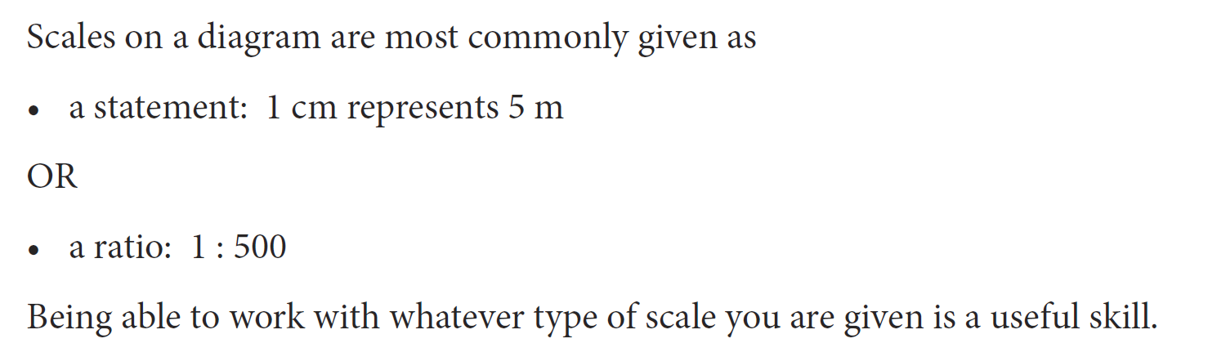

Slide 5



Example 1
Write the scale 1 cm to 1 m in ratio form.
Example 2
Simplify the scale 5 mm : 1 m.
Solution:
Solution:
Example 3
Simplify the scale 5 cm : 2 km.
Solution:

Slide 6
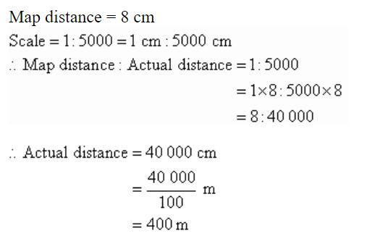
24
7
30
Scale Diagrams
Date
EQ – How do you use a scale diagram?
How to calculate real life distance using scale?
If the scale is 1 : x, then multiply the map distance by x to calculate the actual distance.
Example:
A particular map shows a scale of 1 : 5000. What is the actual distance if the map distance is 8 cm?

Slide 7
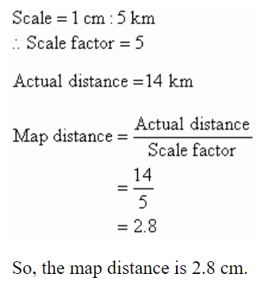
24
7
30
Scale Diagrams
Date
EQ – How do you use a scale diagram?
How to calculate the scaled distance using the real life distance?
If the scale is 1 : x, then divide the actual distance by x to calculate the map distance.
Example
A particular map shows a scale of 1 cm : 5 km. What would the map distance (in cm) be if the actual distance is 14 km?
Solution:

Slide 8
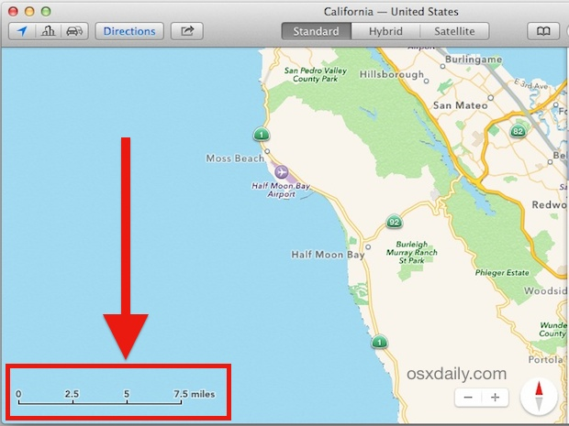
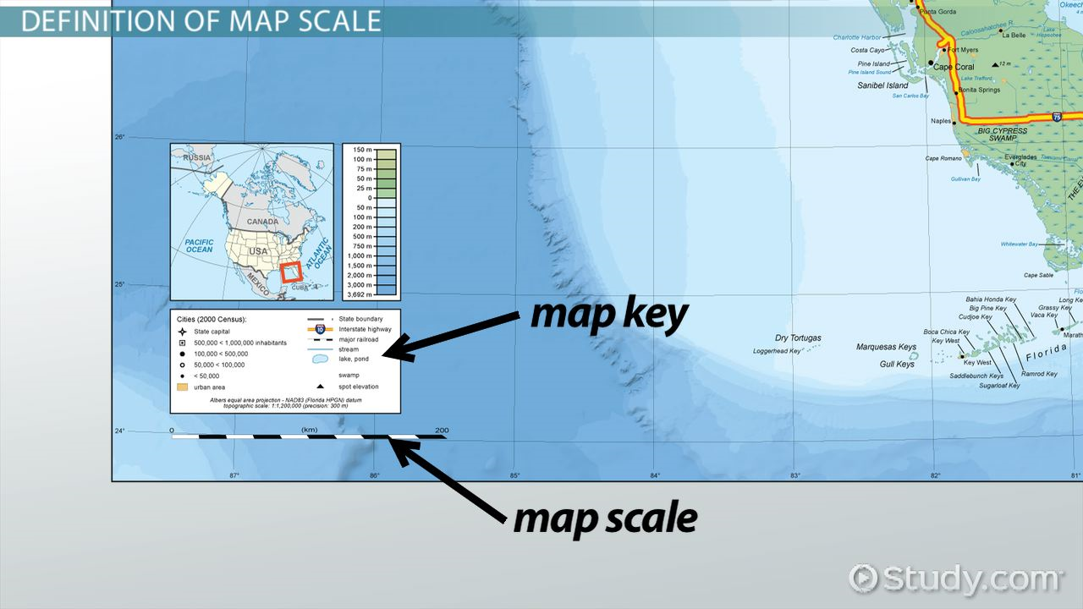

Slide 9


Slide 10
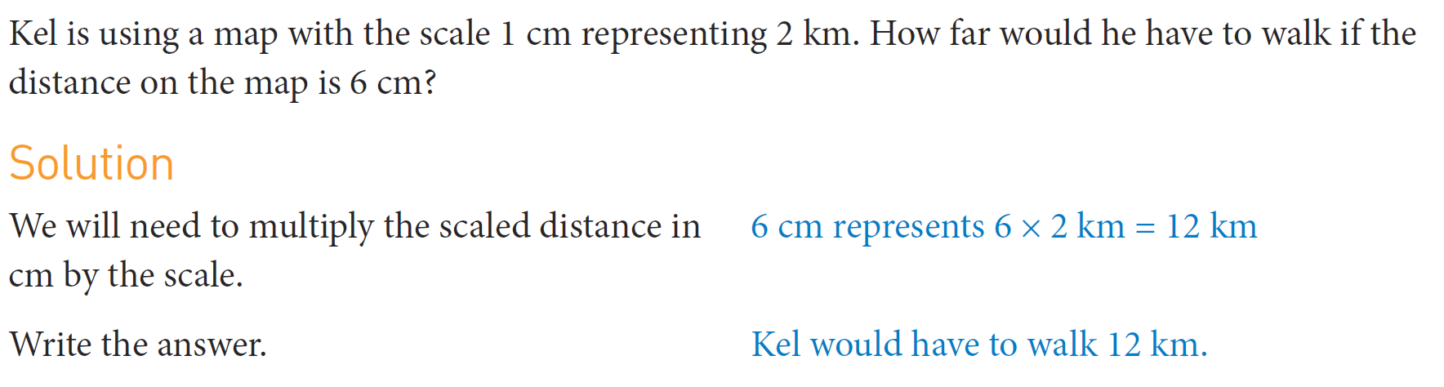
Practice

Slide 11
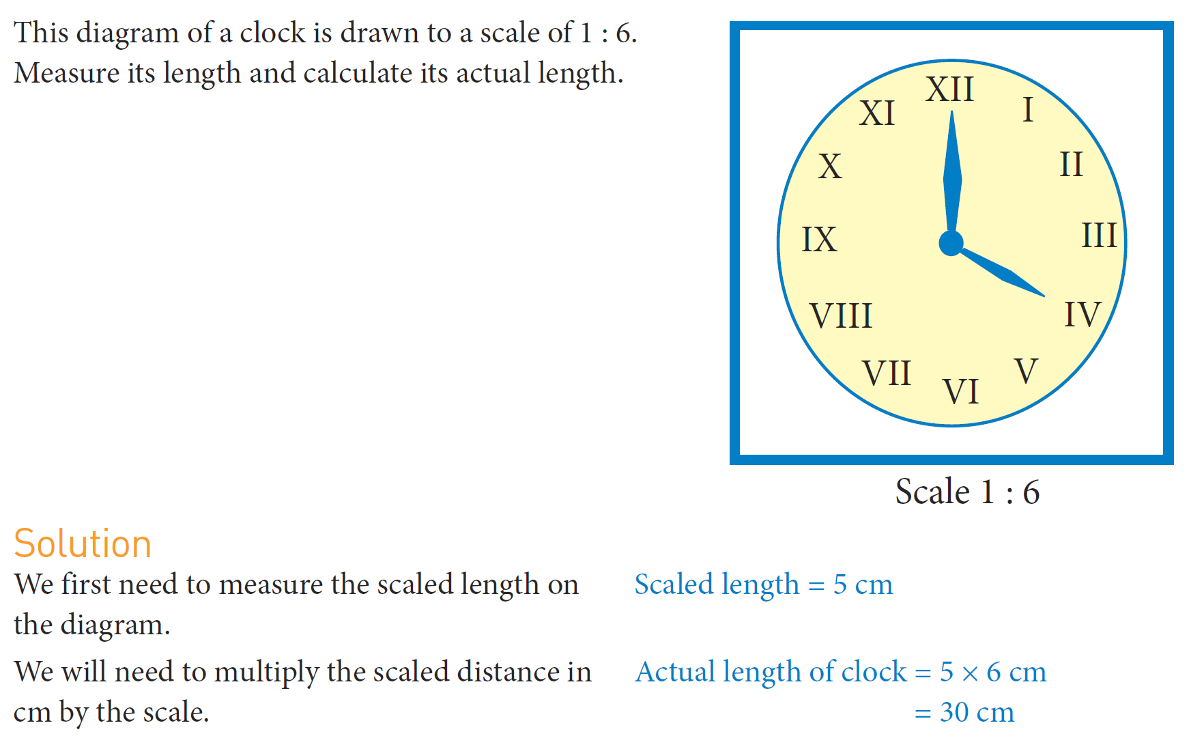
Practice
Cut up your photocopied sheet and glue in your INB

Slide 12
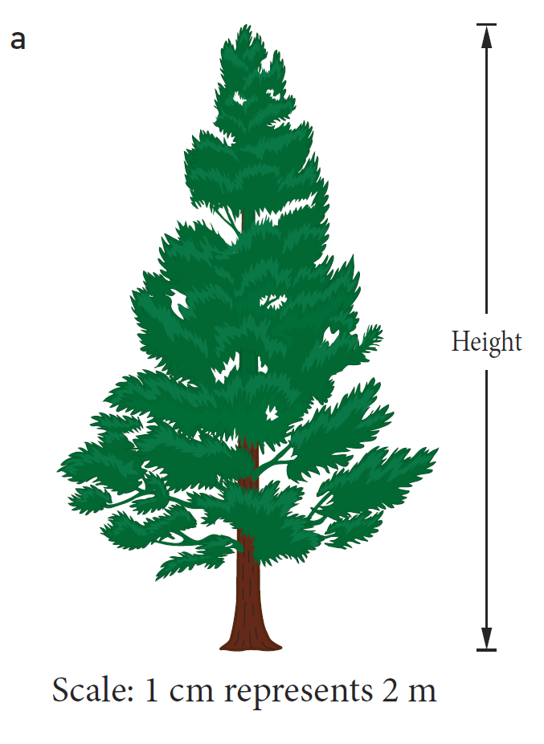
Practice
Cut up your photocopied sheet and glue in your INB

Slide 13
Task
1. Using Scale Drawing Worksheet

